Slide 1

Basics of Neural Network Programming
Computation Graph
deeplearning.ai

Slide 2
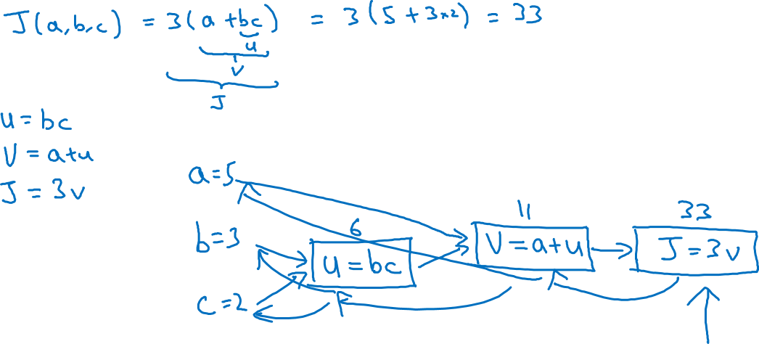
Computation Graph

Slide 3
Basics of Neural Network Programming
Derivatives with a Computation Graph
deeplearning.ai

Slide 4
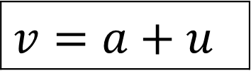

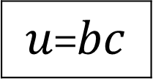



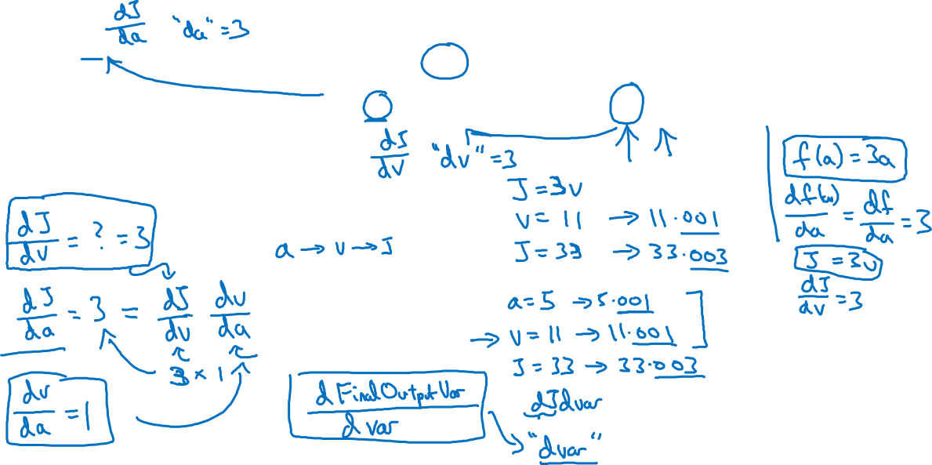
Computing derivatives
$$a=5$$
11
33
$$b=3$$
6
$$v=a+u$$
$J=3v$
$u$=$bc$
$$c=2$$

Slide 5
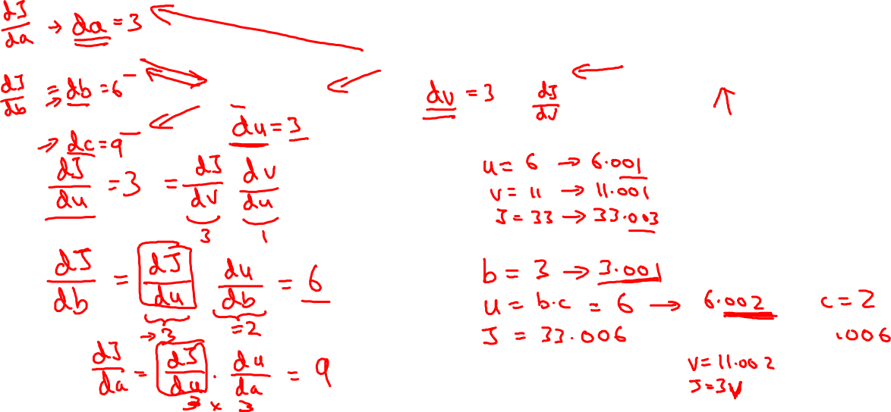
Computing derivatives
$$a=5$$
11
33
$$b=3$$
6
$$v=a+u$$
$J=3v$
$u$=$bc$
$$c=2$$

